Slide 1

ANALYSIS OF BANK DATA
Group Number : 02
Section Number : 004

Slide 2





Team Introduction
Team Members:
Aesha Rathod
Isha Dadhuk
Jasleen Kour Chibber
Kunal Vaghela
Tanveer Kaur

Slide 3
Problem Statement
The Portuguese bank dataset is a real-life dataset that contains information on direct marketing campaigns of a Portuguese banking institution. The problem statement of the dataset is to predict whether a client will subscribe to a term deposit (binary classification) based on a set of demographic, economic, and social indicators.
The dataset contains 21 input variables, including the client's age, job, education, marital status, housing, loan status, etc. The output variable is a binary variable that indicates whether the client has subscribed to a term deposit or not.

Slide 4
Project Proposal
The aim of this project is to develop a predictive model that can accurately predict whether a client will subscribe to a term deposit or not, based on a set of demographic, economic, and social indicators.

Slide 5
Data Cleaning
The Portuguese Bank Marketing dataset contains missing values and categorical variables.
Missing values can be handled by imputation or deletion.
Categorical variables need to be encoded for analysis.
Outliers need to be identified and addressed.
The cleaned dataset should be checked for consistency.
e.g. Balance is in minus then removed, If above 60 age is removed.
Removed unused columns e.g. 'default', 'loan', 'contact', 'day’.

Slide 6
Data Transformation
Data transformation may or may not be needed in the Portuguese Bank Marketing dataset, depending on the specific analysis or modeling task.
Data transformation refers to the process of converting the original data into a different format that better suits the requirements of the analysis or modeling task. It can include tasks such as scaling, normalization, or log transformation.

Slide 7
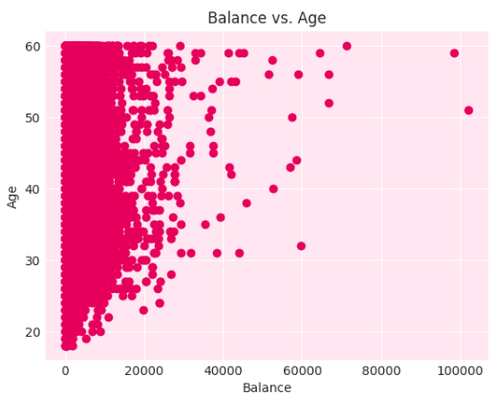
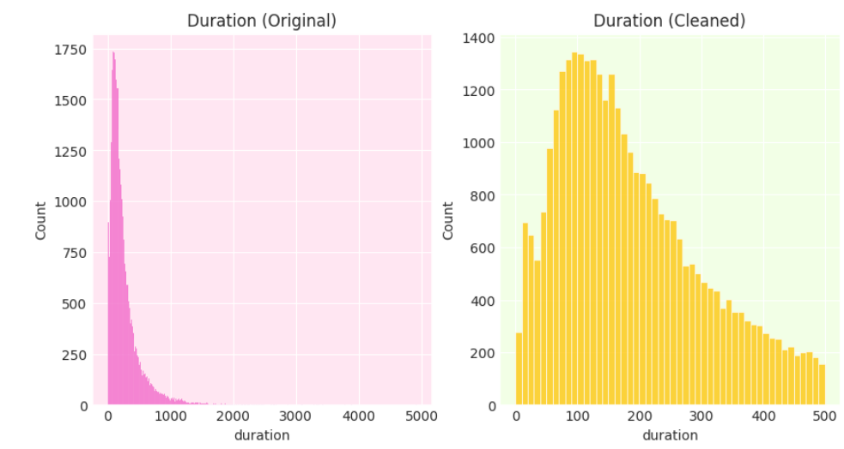
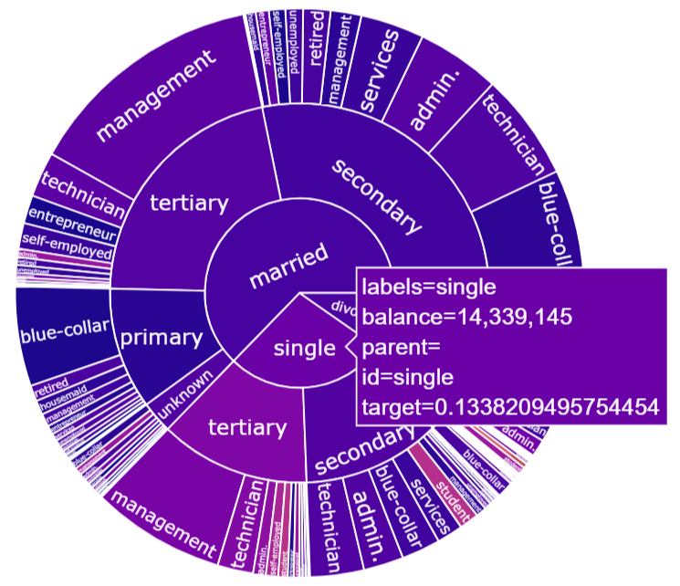
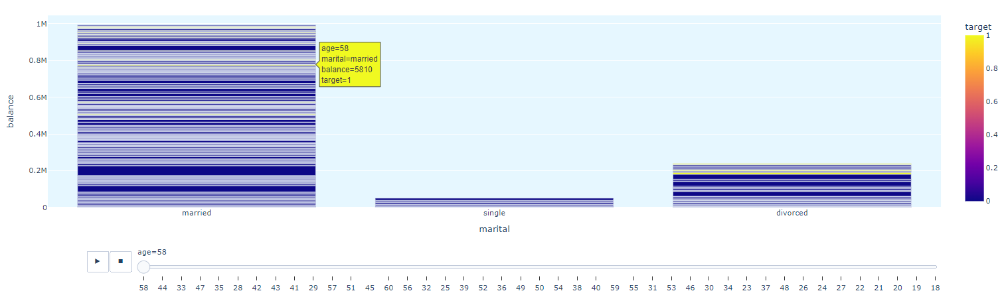
Data Visualization

Slide 8
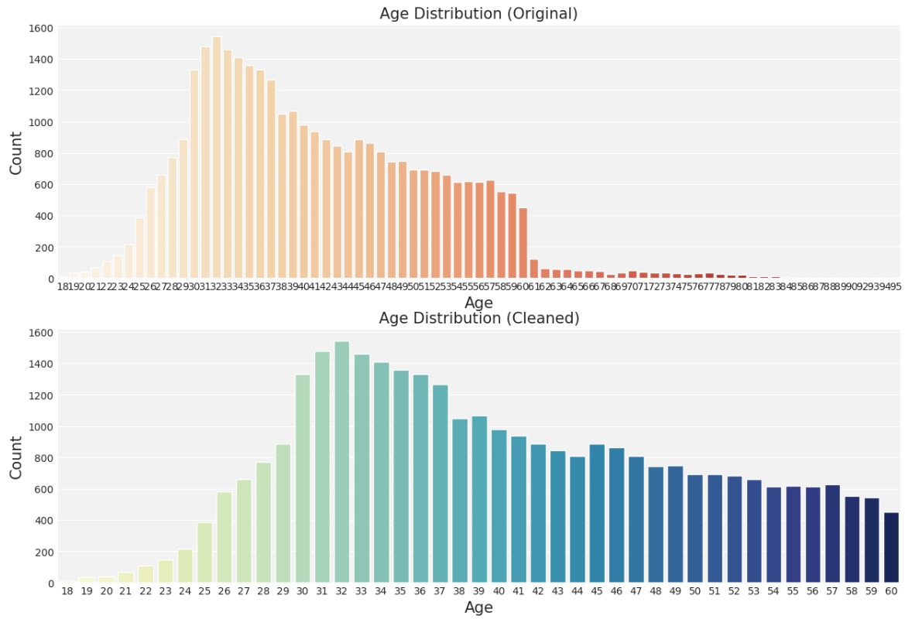
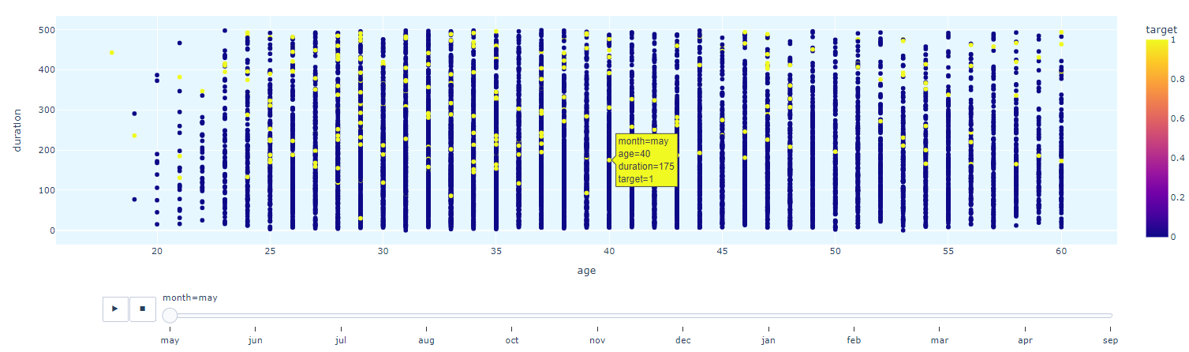
Data Visualization

Slide 9
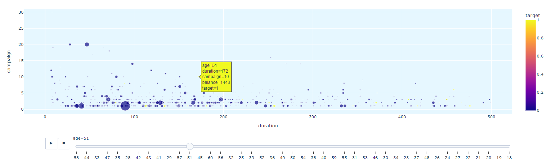
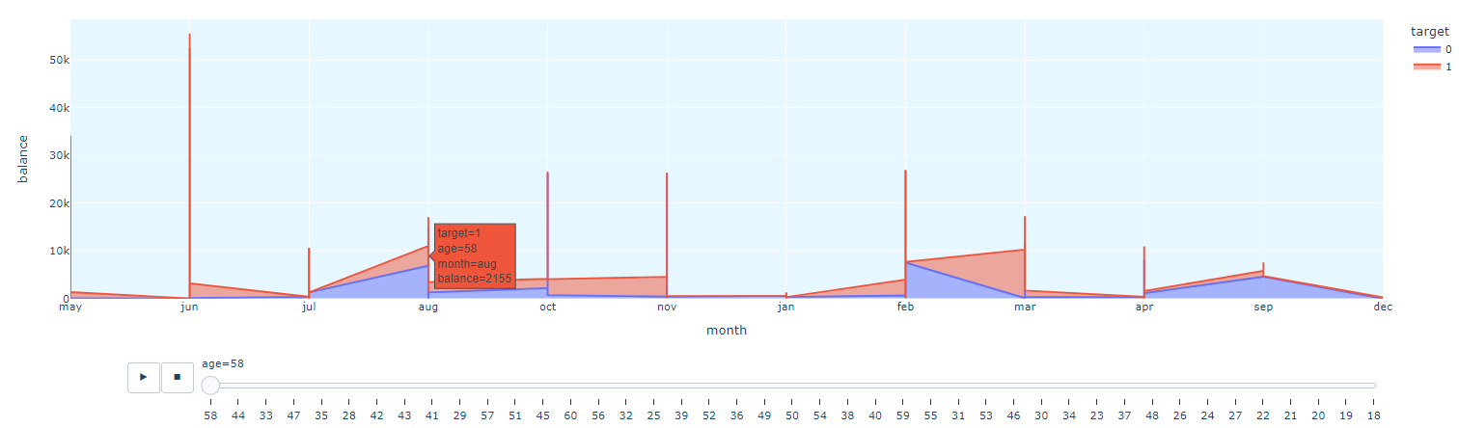
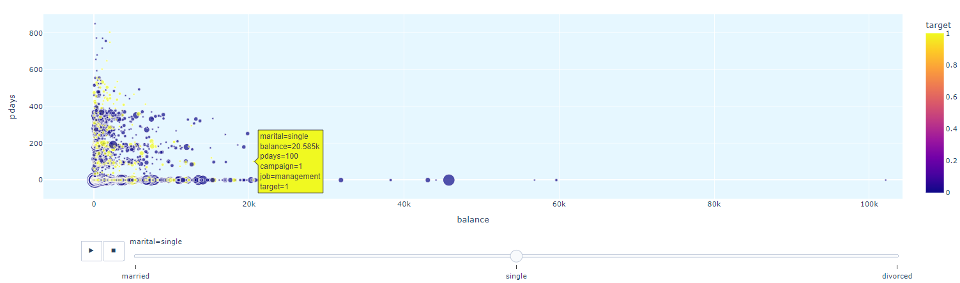

Slide 10
References
Dataset: https://archive.ics.uci.edu/ml/datasets/bank+marketing
W3School: https://www.w3schools.com/python/matplotlib_intro.asp
Seaborn: https://seaborn.pydata.org/tutorial/introduction.html

